Slide 1
Building an ALEXA SKILL
Workshop 8

Slide 2


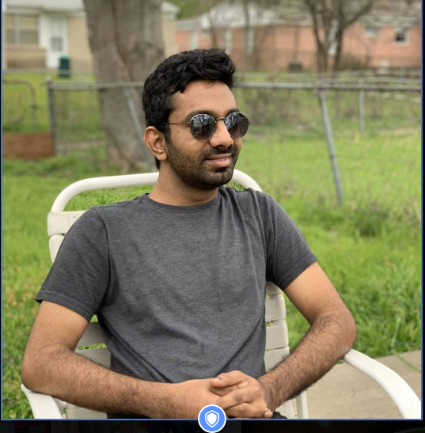
TEAM MEMBERS
MOUNI KRISHNA ATLURI
SAI KRISHNA TEJA KANCHARLA
MALLIKARJUNA BODEPUDI

Slide 3
REQUIREMENTS
Amazon Developer Portal
Alexa Skills Console
Visual Studio 2017
AWS Toolkit for VS
MOUNI KRISHNA ATLURI

Slide 4
Interaction Model
Skill Invocation Name - Used to call the app
Intents - Action that fulfills a user’s voice request
Slots - Variables in utterances
Utterances - set of likely spoken phrases mapped to intents
MOUNI KRISHNA ATLURI

Slide 5
Lambda Function
The easiest way to build the cloud-based service for a custom Alexa skill is by using AWS Lambda, an Amazon Web Services offering that runs your code only when it's needed and scales automatically, so there is no need to provision or continuously run servers.
You upload the code for your Alexa skill to a Lambda function and Lambda does the rest, executing it in response to Alexa voice interactions and automatically managing the compute resources for you.
SAI KRISHNA TEJA KANCHARLA

Slide 6
Lambda Function
Install AWS toolkit in VS
New Account Profile
Access Key Id, Secret Access Key, Account Number
Region is critical
Publish to AWS Lambda
Upload the function
SAI KRISHNA TEJA KANCHARLA

Slide 7
Triggers
You must configure at least one trigger for your function to grant Alexa the necessary invocation permissions for your function.
MALLIKARJUNA BODEPUDI

Slide 8
Triggers
When you add the Alexa Skills Kit as a trigger, it is recommended that you also enable skill ID verification for the function.
MALLIKARJUNA BODEPUDI

Slide 9
Triggers
When using skill ID verification, you do not need to include code to verify that the request is intended for your service. Requests from unverified skills do not invoke your function.
MALLIKARJUNA BODEPUDI

Slide 10
Triggers
Create a trigger to enable the c# lambda function
Requires the Skill ID to configure the trigger
Requires the Skill ID ARN (Amazon Resource Name) value
MALLIKARJUNA BODEPUDI

Slide 11
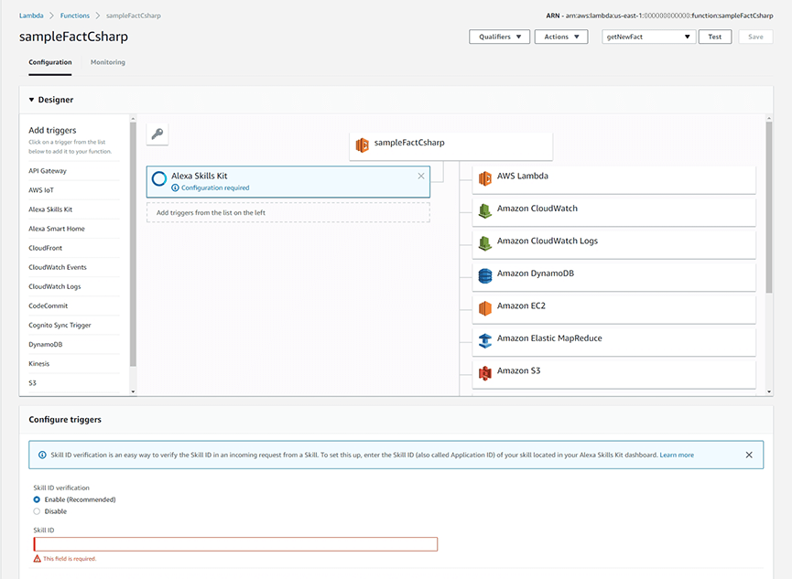
MALLIKARJUNA BODEPUDI

Slide 12
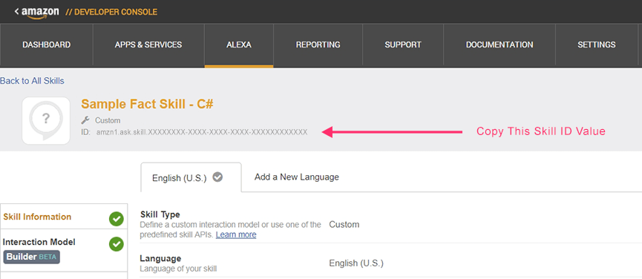
MALLIKARJUNA BODEPUDI

Slide 13
VUI to Lambda
Connection to be established between Voice User Interface and Lambda Function
Select the AWS Lambda ARN option for your endpoint.
Can host anywhere
AWS Free tier - 1M free requests, 3.2M seconds of compute time per month
MOUNI KRISHNA ATLURI

Slide 14
Testing the Skill
Select the skill in Amazon Developer Portal and Test it.
SAI KRISHNA TEJA KANCHARLA

Slide 15
REFERENCES
https://developer.amazon.com/docs/
Amazon Developer Documentation.
Lambda function credits: Jake M Kelly

Slide 16
THANK YOU
ANY QUESTIONS?

